Slide 1
TITLE - Sales Data Processing for Retail Optimization
NAME: DEEPAK P
REG NO: 2347220
SUBMISSION DATE: 19-11-2024

Slide 2
TABLE OF CONTENT
TABLE OF CONTENT
Design Document
Code Implementation
Dataset Documentation
Power BI Dashboard
Azure Workflow Screenshots

Slide 3
Objective: Develop a robust and scalable data pipeline to handle diverse sales data sources and
provide actionable insights for XYZ Retail Inc.
Challenges: Address data fragmentation, scalability issues, inconsistent quality, and real-time processing
limitations to enhance decision-making.
Proposed Solution: Leverage Azure services like Data Factory, SQL Database, and Data Studio to automate
workflows, ensure data security, and enable advanced analytics.
Key Features: Include secure data storage, ETL workflows, pipeline automation, and integration for seamless data
processing and visualization.
System Architecture: Implement centralized storage, structured data processing, and workflow orchestration
for end-to-end data lifecycle management.
HIGH LEVEL DESIGN
TABLE OF CONTENT
High Level Design

Slide 4
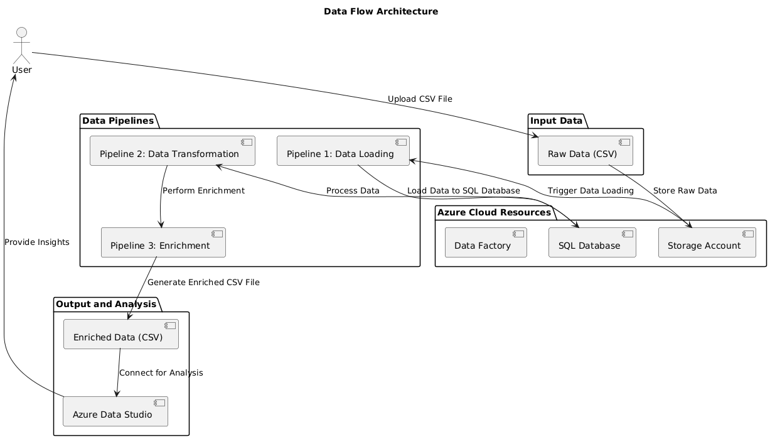
Data Ingestion and Storage: Users upload raw CSV
data, which is securely stored in an Azure
Storage Account and triggers loading into an SQL
Database through Azure Data Factory.
Data Transformation and Enrichment: The data
pipeline consists of three stages—data loading
transformation, and enrichment—ensuring processed
and enriched data is prepared for analysis.
Output and Analysis: The enriched data is stored
in CSV format and connected to Azure Data Studio for
advanced analysis and actionable insights.
System Architecture
TABLE OF CONTENT

Slide 5
Choice of Data Storage
TABLE OF CONTENT
Structured Data Management: Azure SQL Database is ideal for managing structured data, whereas ADLS is better suited for unstructured data2.
Database Management Features: Azure SQL Database offers advanced database management features like automatic tuning, backups, and high availability, which are not available in ADLS.
Ease of Use: Azure SQL Database provides a more user-friendly interface for SQL developers and database administrators.
Performance Optimization: Automatic tuning and performance optimization features in Azure SQL Database help maintain optimal performance without manual intervention.

Slide 6
Code Implementation
TABLE OF CONTENT
Load raw data.
Validate schema and handle missing values.
Calculate Total_Sales.
Aggregate metrics by location.
Anonymize sensitive data (e.g., credit card numbers).

Slide 7
Dataset Documentation
TABLE OF CONTENT
Dataset Summary: 99 records with 11 columns of sales data.
Key Details: Includes customer, product, and order information.
Data Types: Text, numbers, and dates in DD-MM-YYYY format.
Missing Data: Some prices are missing.
Insights: Useful for analyzing sales trends and customer preferences.

Slide 8
Dataset Preprocessing
TABLE OF CONTENT
Data Loading: Used the pandas library to load and analyze the dataset.
Missing Data: Identified missing values in the Price column for handling.
New Column: Created TotalSales = Quantity × Price to calculate revenue per order.
Data Validation: Verified numeric columns and ensured critical fields like OrderID and Product are non-null.
Data Saving: Saved the enriched dataset with new columns into a CSV file for further use.

Slide 9
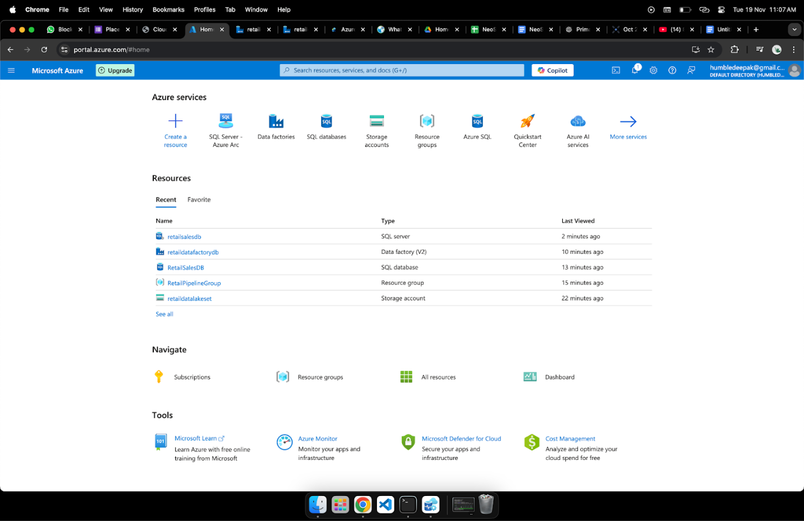
TABLE OF CONTENT
Azure Workflow

Slide 10
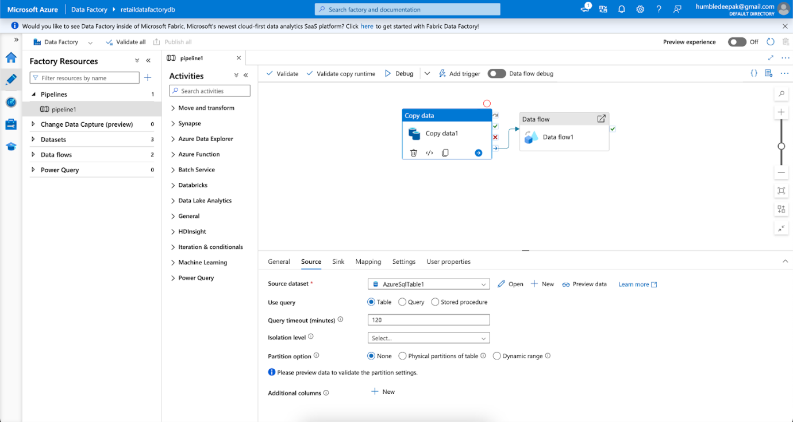
TABLE OF CONTENT
Pipeline Dataflow

Slide 11
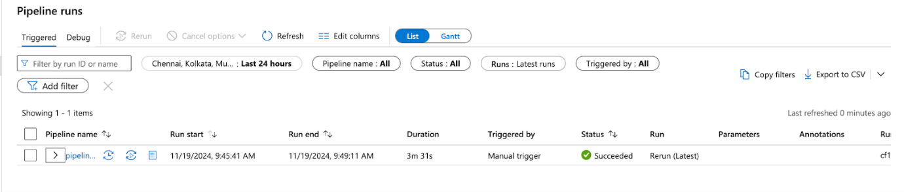
TABLE OF CONTENT
Pipeline Trigger

Slide 12
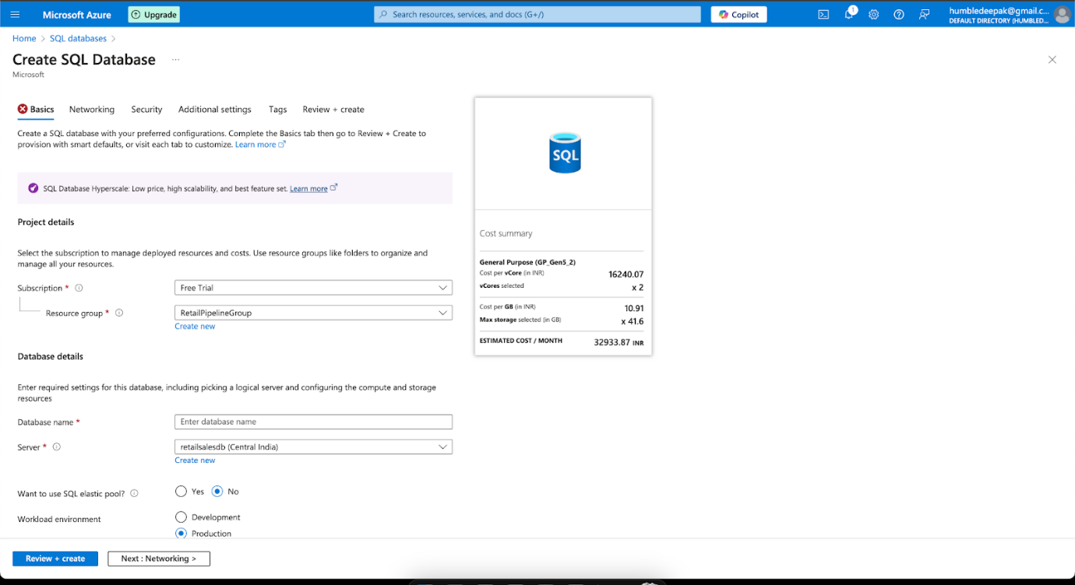
Azure SQL Database Files
TABLE OF CONTENT

Slide 13
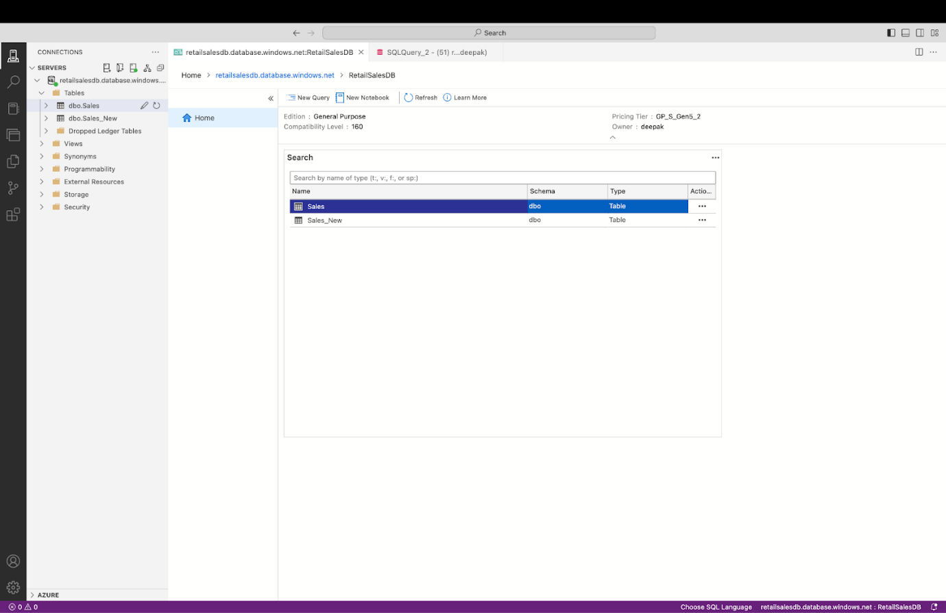
TABLE OF CONTENT
Azure Data Studio

Slide 14
Top Product Performance: Phones dominate sales with 73M in revenue, while other products like laptops and tablets contribute significantly less.
Quantity Sold: Laptops lead in total quantity sold (2.7K units), followed by phones (0.8K units), with minimal sales
for headphones and tablets.
Regional Sales Insights: Major sales contributions come from cities like Houston, New York, and Chicago,
with regional variation in product popularity.
Seasonal Trends: A significant spike in total sales is observed in January, with other months showing minimal sales activity.
Expiry Trends: The highest count of expired products occurs in August (24 products), highlighting inventory
management opportunities.
TABLE OF CONTENT
Power BI Insights

Slide 15
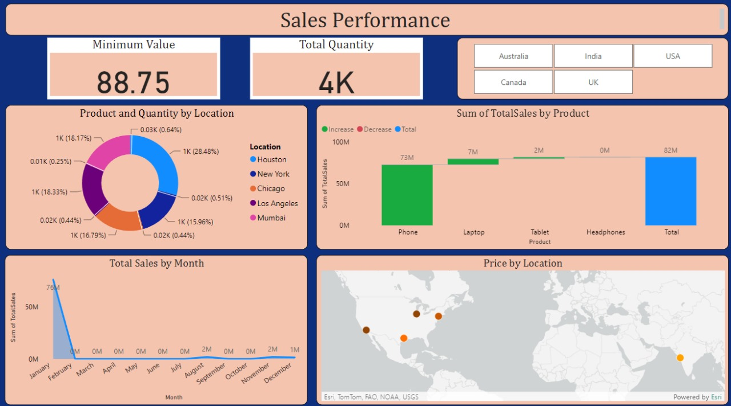
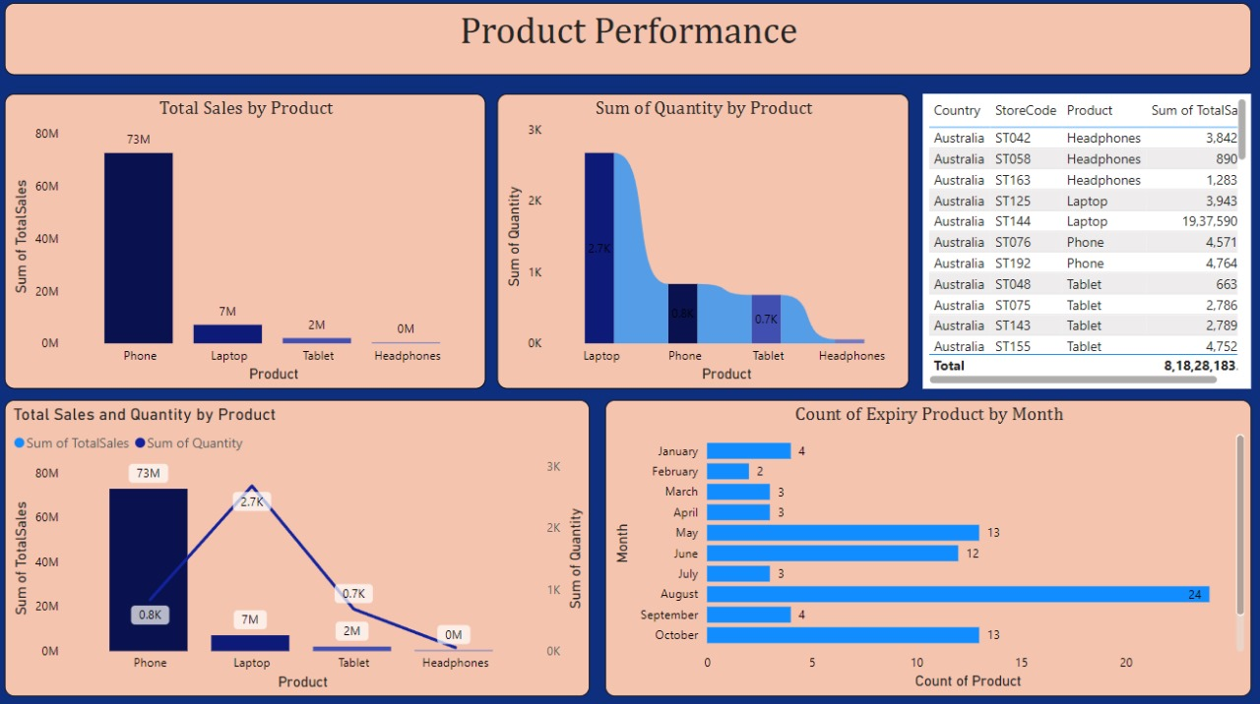
Power BI Dashboard
TABLE OF CONTENT

Slide 16
Sales Summary: Total sales amount to 82M, driven mainly by phones (73M), followed by laptops (7M).
Quantity Distribution by Location: Houston leads with 28.48% of sales, followed by Chicago (18.33%) and New York (18.17%).
Monthly Sales Trend: January shows a significant spike in sales (76M), with negligible sales in other months.
Product Insights: Phones dominate the sales category, while headphones show minimal contribution to overall revenue.
Geographic Pricing: Price distribution visualized geographically highlights sales hotspots in key cities like Houston, New York, and Chicago.
TABLE OF CONTENT
Sales Overview

Slide 17
Product Performance
TABLE OF CONTENT
Product Performance: Phones generate the highest revenue at 73M, significantly outpacing laptops (7M) and tablets (2M), while headphones show negligible sales.
Quantity Analysis: Laptops lead in total quantity sold (2.7K units), followed by phones (0.8K units), with headphones contributing the least.
Expiry Trends: August has the highest count of expired products (24 items), highlighting a need for better inventory management during this period.
Store and Country Insights: Australia contributes significantly to total sales with high-performing stores like ST144 generating notable revenue (19.37M).
Combined Metrics: A clear correlation between total sales and quantity sold is observed, with phones having the highest sales but fewer units sold compared to laptops

Slide 18
Phones dominate revenue with 73M, followed by laptops (7M) and tablets (2M), while headphones show negligible
sales.
Laptops lead in units sold (2.7K), indicating high demand despite lower revenue compared to phones.
Australia emerges as the top-performing region, with significant contributions from store ST144.
August recorded the highest count of expired products (24 items), pointing to inventory issues.
Total revenue stands at 8,18,28,183, reflecting strong overall sales performance.
TABLE OF CONTENT
Results and outcomes

Slide 19

THANK YOU
THANK YOU

